Slide 1



Introduction to ASP .NET MVC

Slide 2
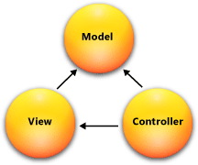
What is MVC?
Model-View-Controller (MVC)
Standard Architectural Pattern
Separation of concerns: model, view, controller

Slide 3

Model
Set of classes that describes the data we are working with
Rules for how the data can be changed and manipulated
May contain data validation rules
Often encapsulate data stored in a database
as well as code used to manipulate the data
Most likely a Data Access Layer of some kind
Apart from giving the data objects
It doesn't have significance in the framework

Slide 4
View
Defines how the application’s user interface (UI) will be displayed
May support master views (layouts)
May support sub-views (partial views or controls)
Web: Template to dynamically generate HTML

Slide 5
Controller
The core MVC component – holds the logic
Process the requests with the help of views and models
A set of classes that handles
Communication from the user
Overall application flow
Application-specific logic
Every controller has one or more "actions"

Slide 6
MVC Steps
Incoming request routed to Controller
For web: HTTP request
Controller processes request and creates presentation Model
Controller also selects appropriate result (view)
Model is passed to View
View transforms Model into appropriate output format (HTML)
Response is rendered (HTTP response)

Slide 7
The MVC Pattern for Web
HTTP Request
Front controller (dispatcher)
/Some/Page/
Delegate request
User
Controller
HTTP Response
CRUD model
Select view & pass data
View
(render UI)
Model (data)
Use model data

Slide 8
MVC Frameworks
PHP: CakePHP, CodeIgniter, Laravel
Java: Spring
Perl: Catalyst, Dancer
Python: Django, Flask, Grok
Ruby: Ruby on Rails, Camping, Nitro, Sinatra
JavaScript: AngularJS, JavaScriptMVC, Spine
ASP.NET MVC (.NET Framework)

Slide 9
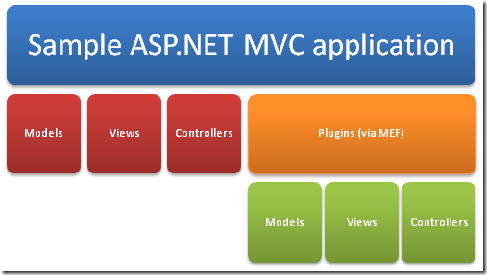
ASP .NET MVC Framework
An alternative to ASP .NET Web Forms
Presentation framework
Lightweight
Highly testable
Integrated with the existing ASP .NET features:
Master pages
Membership-Based
Authentication
...

Slide 10
ASP .NET MVC Framework Components
Models
Business/domain logic
Model objects, retrieve and store model state in a persistent storage (database).
Views
Display application’s UI
UI created from the model data
Controllers
Handle user input and interaction
Work with model
Select a view for rendering UI

Slide 11
When to use MVC approach?
Advantages:
Easier to manage complexity (divide and conquer)
It does not use server forms and view state
Front Controller pattern (rich routing)
Better support for test-driven development
Ideal for distributed and large teams
High degree of control over the application behavior

Slide 12
ASP .NET MVC Features
Separation of application tasks
Input logic, business logic, UI logic
Support for test-driven development
Unit testing
No need to start app server
Extensible and pluggable framework
Components easily replaceable or customized (view engine, URL routing, data serialization,…)

Slide 13
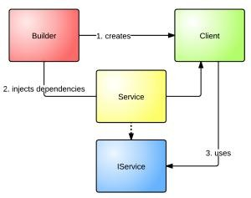
ASP .NET MVC Features (cont.)
Support for Dependency Injection (DI)
Injecting objects into a class
Class doesn’t need to create objects itself
Support for Inversion of Control (IOC)
If an object requires another object, the first should get the second from an outside source (configuration file)

Slide 14
ASP .NET MVC Features (cont.)
Extensive support for ASP .NET routing
Building apps with comprehensible and searchable URLs
Customizable URLs
Adapted to work well with search engines
Adapted to REST addressing
Decoupled from resource files
Use of existing ASP .NET features (backward compatibility)

Slide 15
ASP .NET MVC App Structure
URLs mapped to controller classes
Controller
handles requests,
executes appropriate logic and
calls a View to generate HTML response
URL routing
ASP .NET routing engine (flexible mapping)
Support for defining customized routing rules
Automatic passing/parsing of parameters

Slide 16
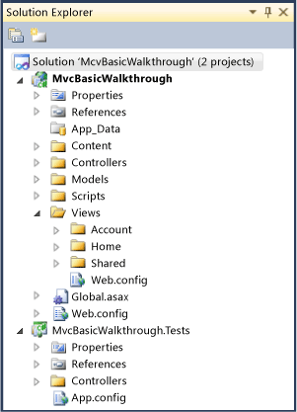
ASP .NET App Structure
No Postback interaction!
All user interactions routed to a controller
No view state and page lifecycle events

Slide 17
MVC App Execution
Entry points to MVC:
UrlRoutingModule and MvcRouteHandler
Request handling:
Select appropriate controller
Obtain a specific controller instance
Call the controller’s Execute method

Slide 18
MVC App Execution - stages
Receive first request for the application
Populating RouteTable
Perform routing
Create MVC Request handler
Create controller
Execute controller
Invoke action
Execute result
ViewResult, RedirectToRouteResult, ContentResult, FileResult, JsonResult, RedirectResult

Slide 19
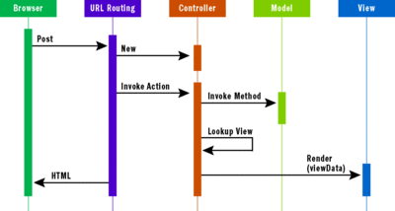
MVC App Execution

Slide 20
BUILDING VIEW PAGES USING RAZOR LANGUAGE
RAZOR ENGINE

Slide 21
Razor Engine
A new view-engine
Optimized around HTML generation
Code-focused templating approach

Slide 22
Razor Engine – Design goals
Compact, Expressive and Fluid
Easy to learn
It is not a new language
Works with any text editor
Great Intellisense
Unit-testable
– Testing views without server, controllers…

Slide 23



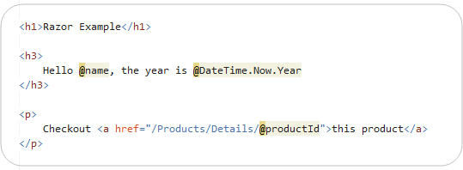
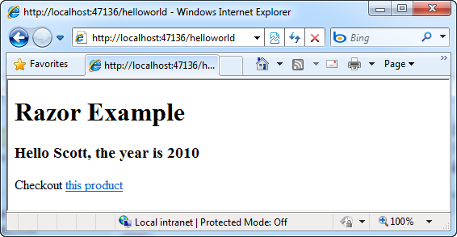

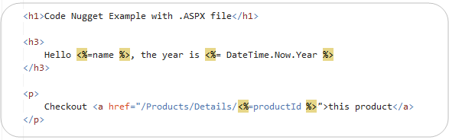

Razor – HelloWorld
Uses @ for Razor blocks
razor file
.aspx file

Slide 24






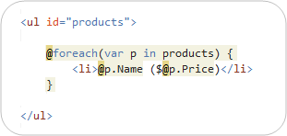
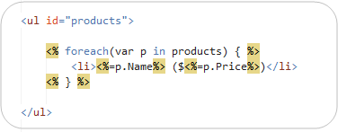
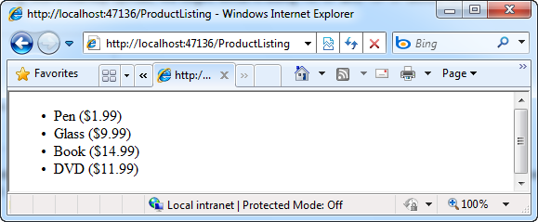
Loops and Nested HTML
Razor syntax .aspx syntax

Slide 25






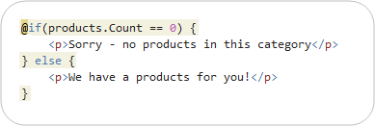





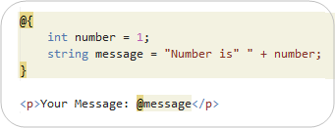
If Blocks and Multi-line Statements
Multi-Token statement
IF statement
Multi-line statement
Variables can span multiple server code blocks!

Slide 26



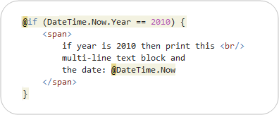
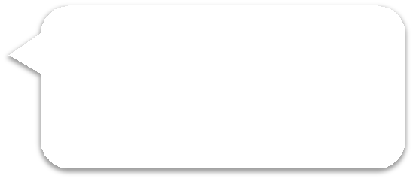


Integrating Content and Code
Parser examines right-hand side of @ character.
Identifying nested content with HTML block tag

Slide 27
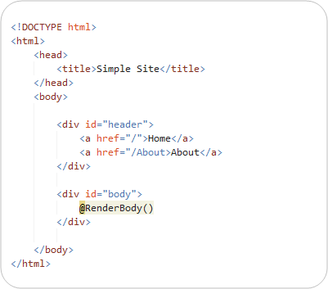





Layout/Master page
SiteLayout.cshtml
@RenderBody() Including specific body content.

Slide 28
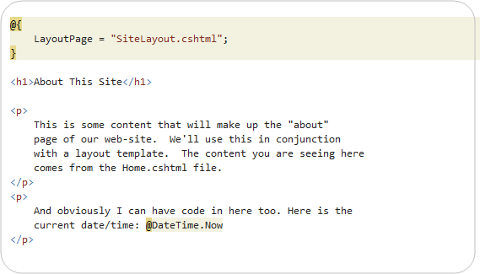


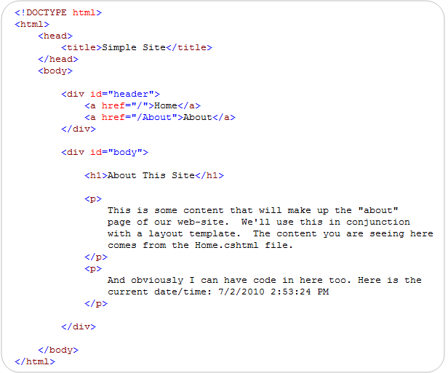



Content page
Explicitly setting LayoutPage property.
Complete HTML page.

Slide 29
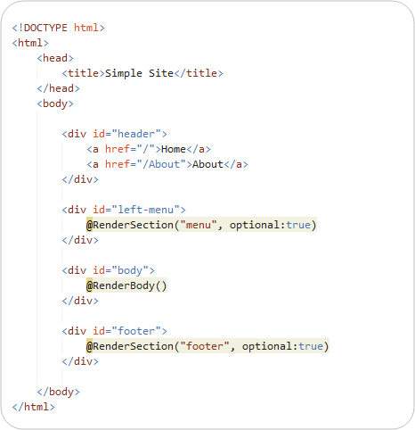



Master page – section overrides
This section is optional.
This section is optional.

Slide 30
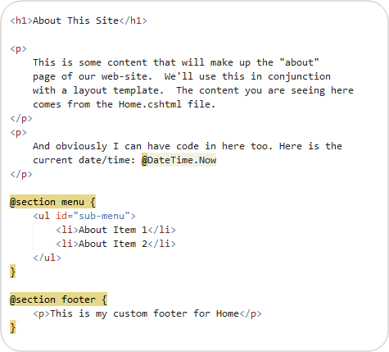





Master page – section overrides
Named section.
Named section.

Slide 31
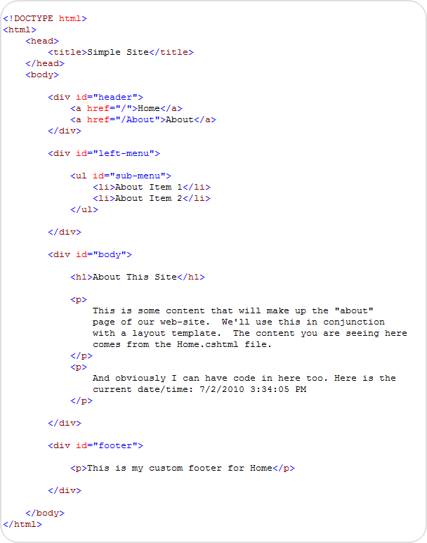
Master page – result html

Slide 32
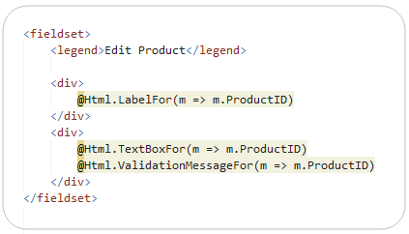



Re-usable “HTML Helpers”
Methods that can be invoked within code-blocks
Encapsulate generating HTML
Implemented using pure code
Work with Razor engine
Built-in HTML helper

Slide 33






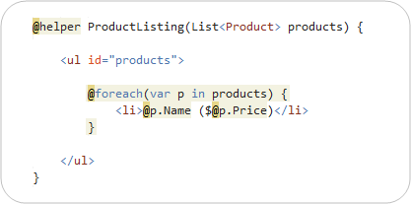





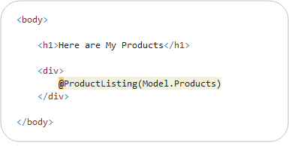



Define own HTML helpers
@helper declarative syntax
Helper’s parameters (full language and ebugging support)
HTML Helper definition
HTML Helper should be placed to Views\Helper directory.
HTML Helper Invocation

Slide 34
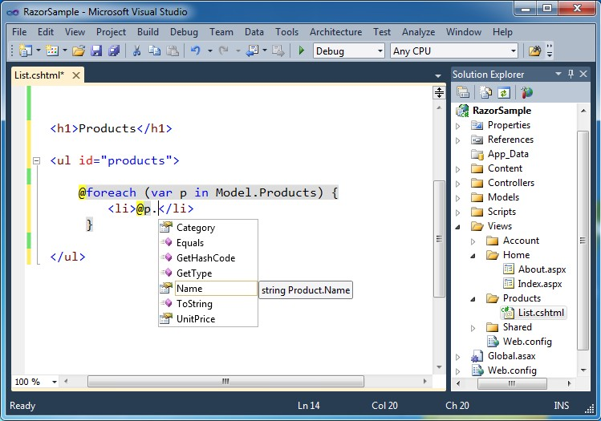
Visual Studio support

Slide 35
Razor – Summary
A good new view engine
Code-focused templating
Fast and expressive
Compact syntax
Integrated with C# and VB

